Slide 1
Attrition Analysis
Shelby Provost

Slide 2
Executive Summary
Age of Attrition is Lower than Age of Retention
No linear relationship between Monthly Income and Age and no relationship between Hourly Income and Gender
Managers have the highest average hourly rate and the highest average number of years spent with the company
Healthcare representatives have highest job satisfaction
Human resources has the highest average relationship satisfaction with their manager
Sales representatives have the highest attrition rate

Slide 3
Interesting Observations

Slide 4
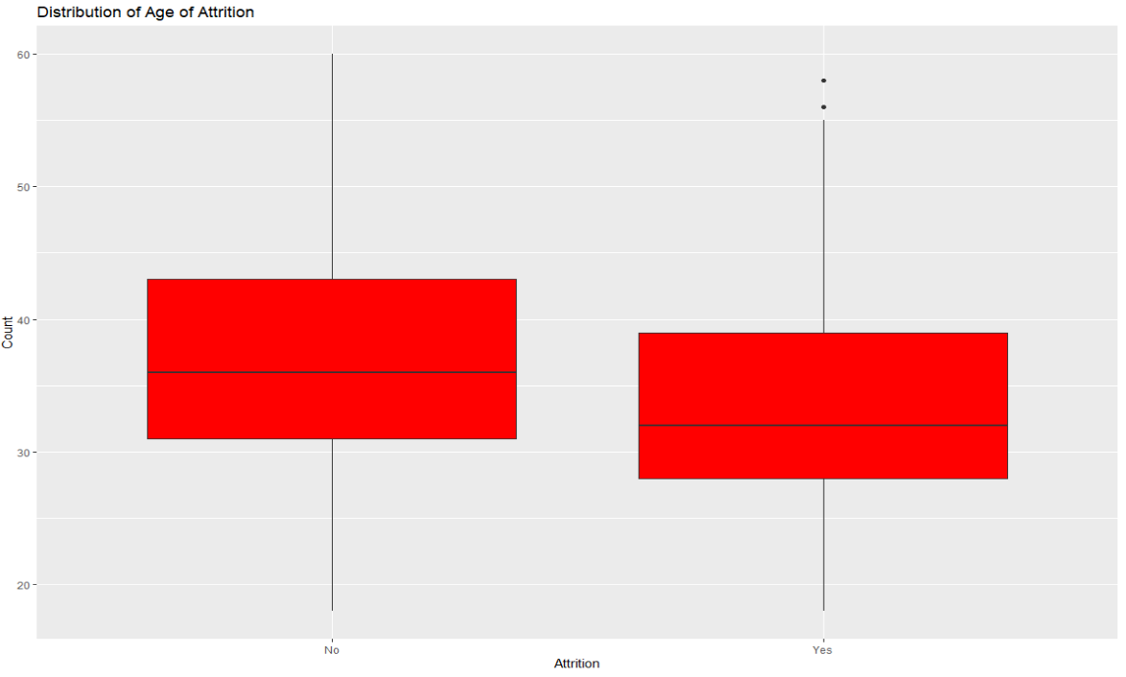
Age of Attrition
The average age of attrition is lower than the average age of retention.

Slide 5
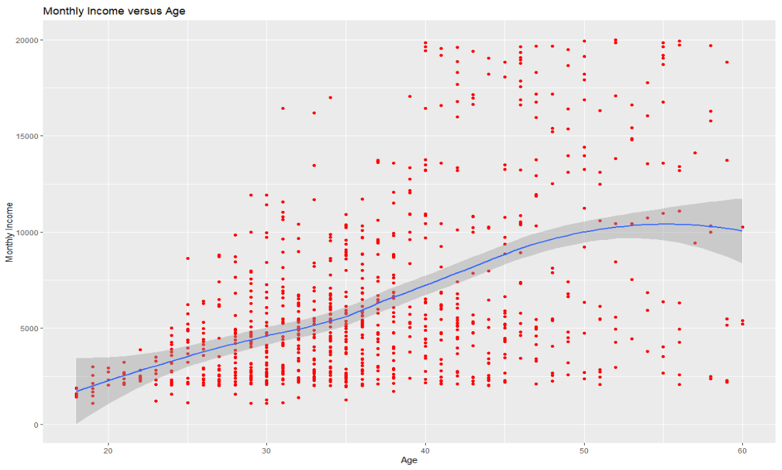
Monthly Income Vs Age
There is no linear relationship between age and monthly income. A possible other relationship may be present.

Slide 6
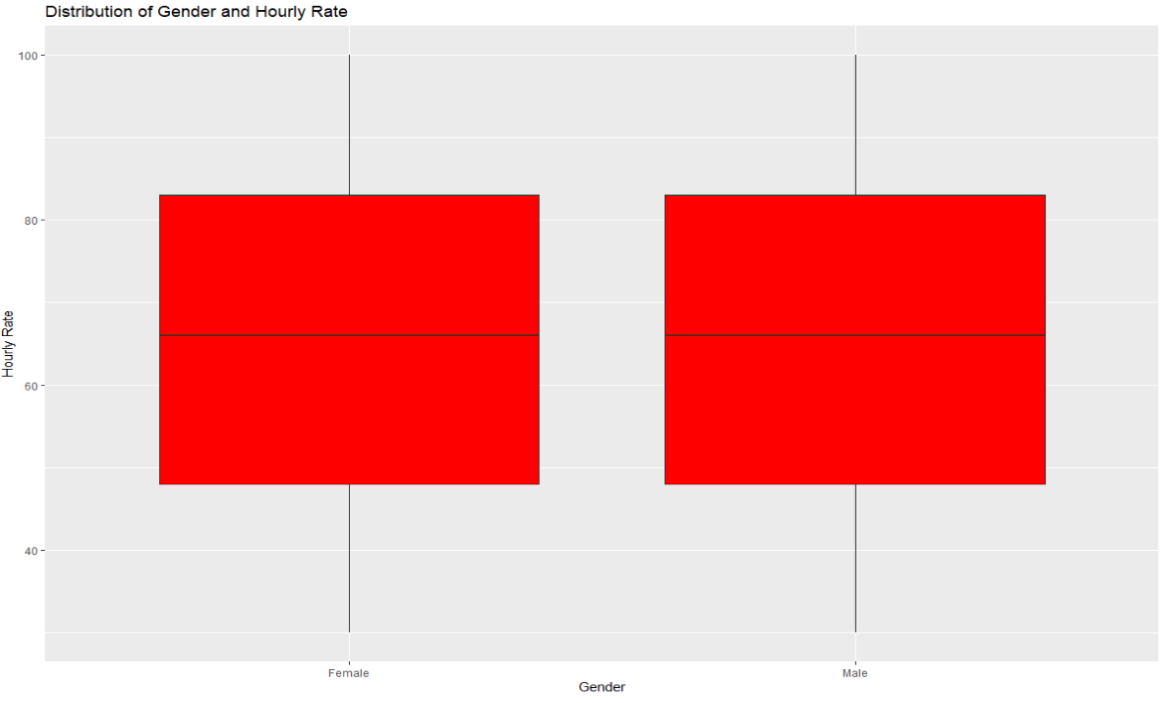
Hourly Income By Gender
There is no difference in the distribution of hourly rate by gender.

Slide 7
Job Role Specific Trends

Slide 8
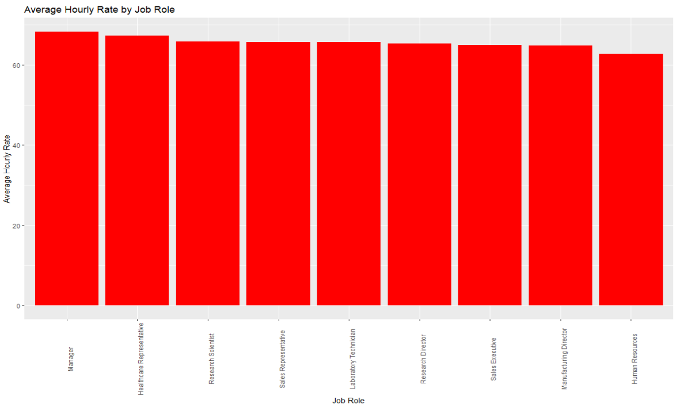
Average Hourly Rate By Job Role

Slide 9
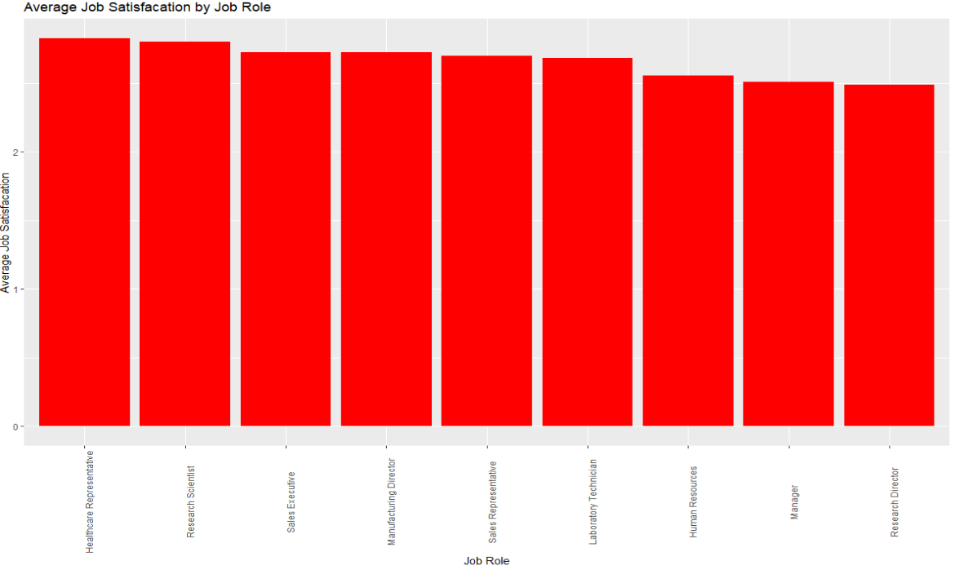
Average Job Satisfaction by Job Role

Slide 10
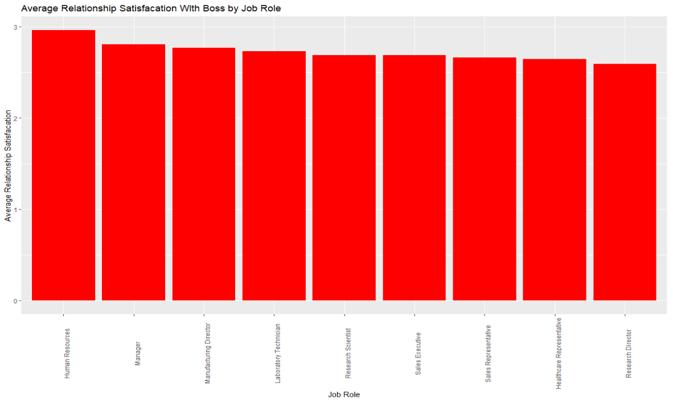
Average Relationship Satisfaction by Job Role

Slide 11
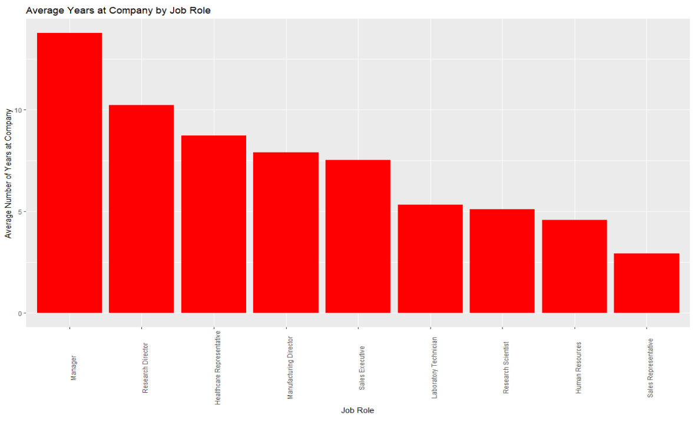
Average Number of Years At Company by Job Role

Slide 12
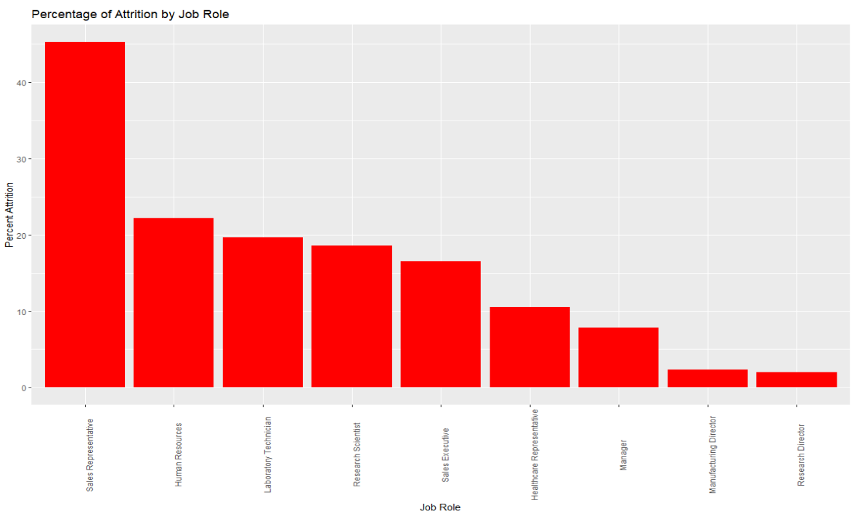
Attrition Rate by Job Role

Slide 13
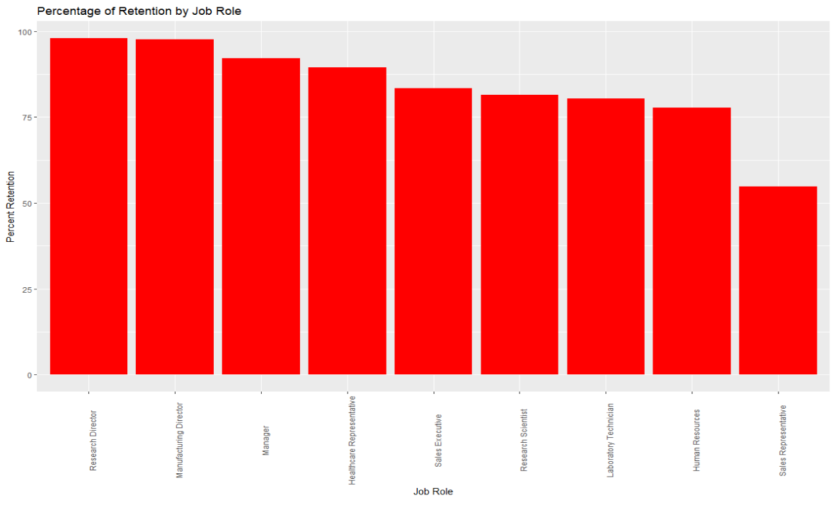
Retention Rate by Job Role

Slide 14
Models

Slide 15
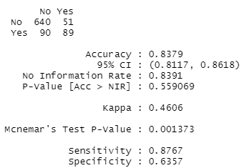
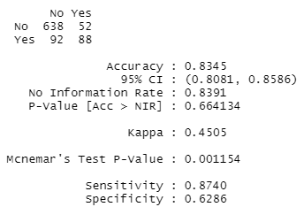
Attrition Model
Model 1: All Variables
Mod 2: Some Variables Removed
We were able to attain 60% sensitivity and specificity in the model with all variables.

Slide 16
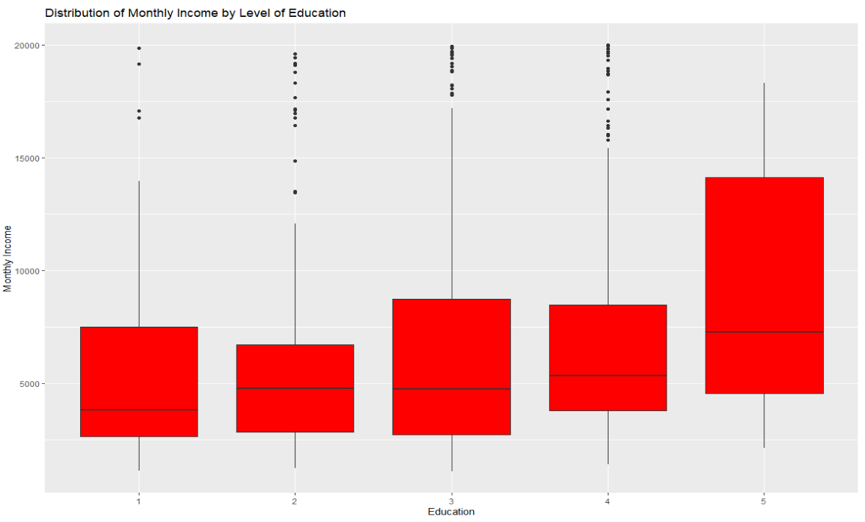
Exploring Linear Trends with Monthly Income – Education

Slide 17
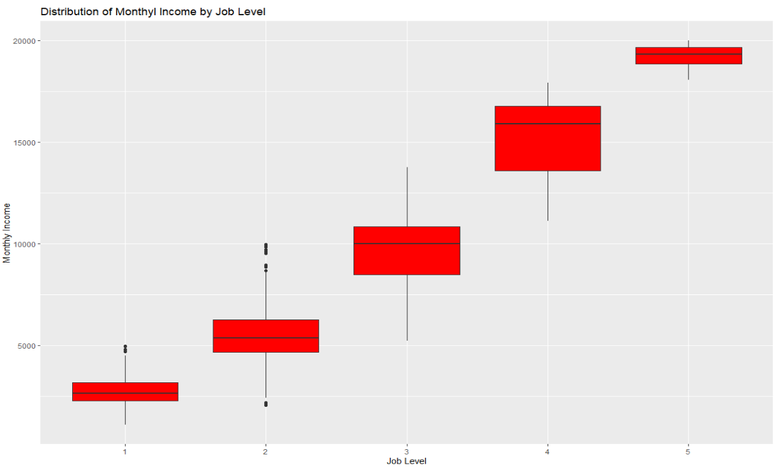
Exploring Linear Trends with Monthly Income – Job Level

Slide 18
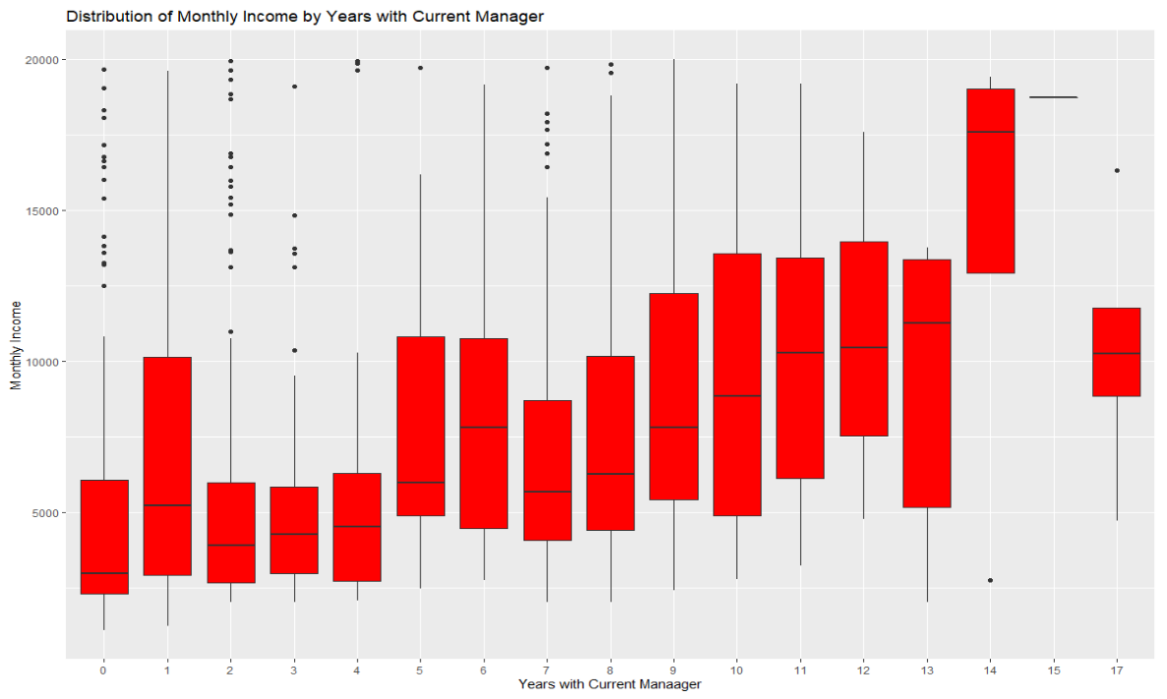
Exploring Linear Trends with Monthly Income – Years with Current Manager

Slide 19
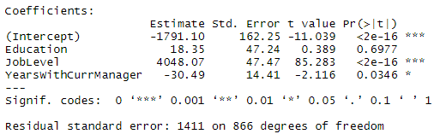
Salary (Monthly Income) Model
Salary(Monthly Income) = -1791.10 + 18.35(Education) + 4048.07(Job Level) – 30.49(Years With Current Manager)
We were able to attain an RMSE of $1411 with this model.

Slide 20
YouTube Presentation Link
https://youtu.be/zBg-wziVkCs

